Slide 1

TITLE OF THE PROJECT
END SEMESTER ASSESSMENT (ESA) B.TECH. (CSE) III SEMESTER
DIGITAL DESIGN & COMPUTER ORGANIZATION LABORATORY UE18CS206
Project Number:12 Project Batch No: 15
Student1 Name : RAZIK FATIN SHARIFF Student2 Name : REKHA C
Student3 Name : REYYALA CHETHAN Student4 Name: RIA SINGH
SRN: PES2UG19CS323 SRN:PES2UG19CS324 SRN:PES2UG19CS325 SRN: PES2UG19CS326

Slide 2
ABSTRACT OF THE PROJECT :
We have designed and implemented a 16-bit Shift Adder (Serial Adder), a combinational logic circuit that performs the addition of two binary numbers in serial form. Serial binary adder performs binary addition bit by bit simultaneously during each clock cycle.
The application of Full Adders, Registers, Multiplexers, and a few other basic modules have been done in the Verilog code to construct the Serial Adder. Two shift registers are used to store the binary numbers that are to be added. The circuit adds one pair at a time with the help of one full adder. The circuit adds one pair at a time with the help of one full adder. However the sum bit from the output of the full adder can be transferred into a third shift register.
The circuit diagram included gives an overall idea of the electrical circuit, parts and how it has been connected in order to derive the necessary results. Gtkwave is the waveform analyzer and is the primary tool used for the visualization and hence get the output waveform of the Serial Adder. If speed is not a major factor, then serial adders are a much more cost effective way.

Slide 3
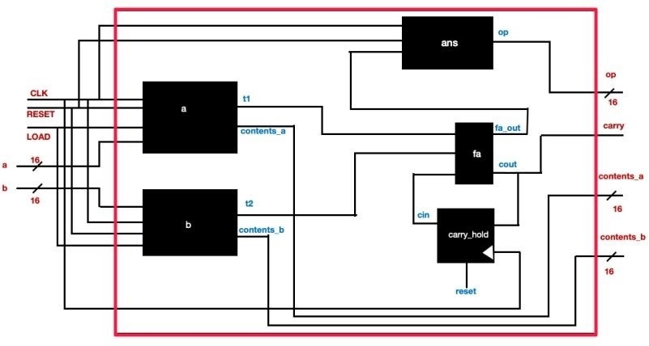
CIRCUIT DIAGRAM
16 BIT – SHIFT ADDER (SERIAL)

Slide 4
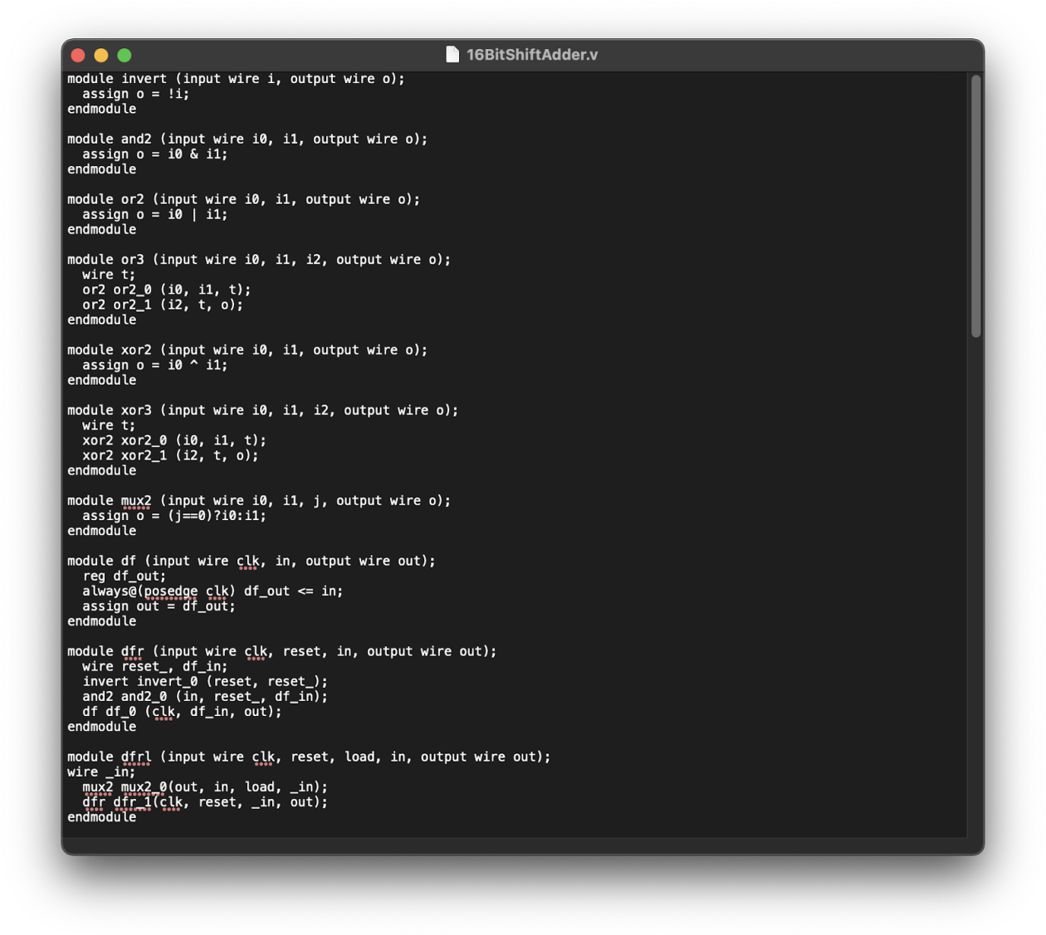
VERILOG CODE USED (TEST BENCH NOT REQUIRED)

Slide 5
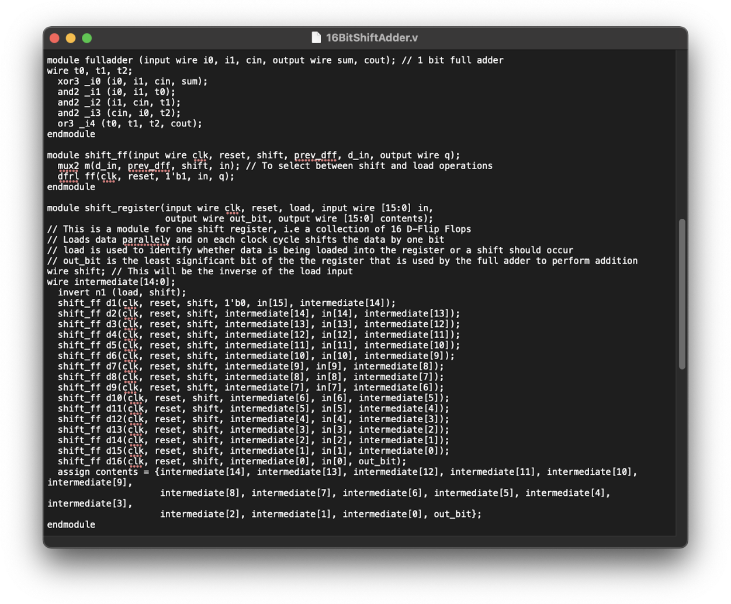

Slide 6
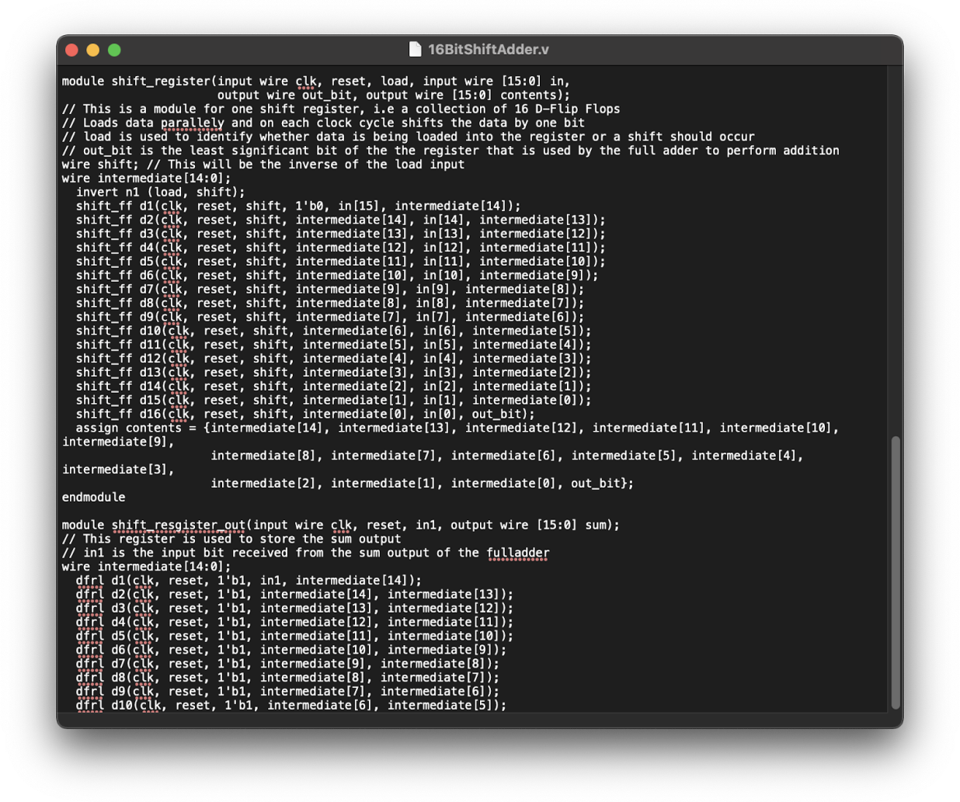

Slide 7
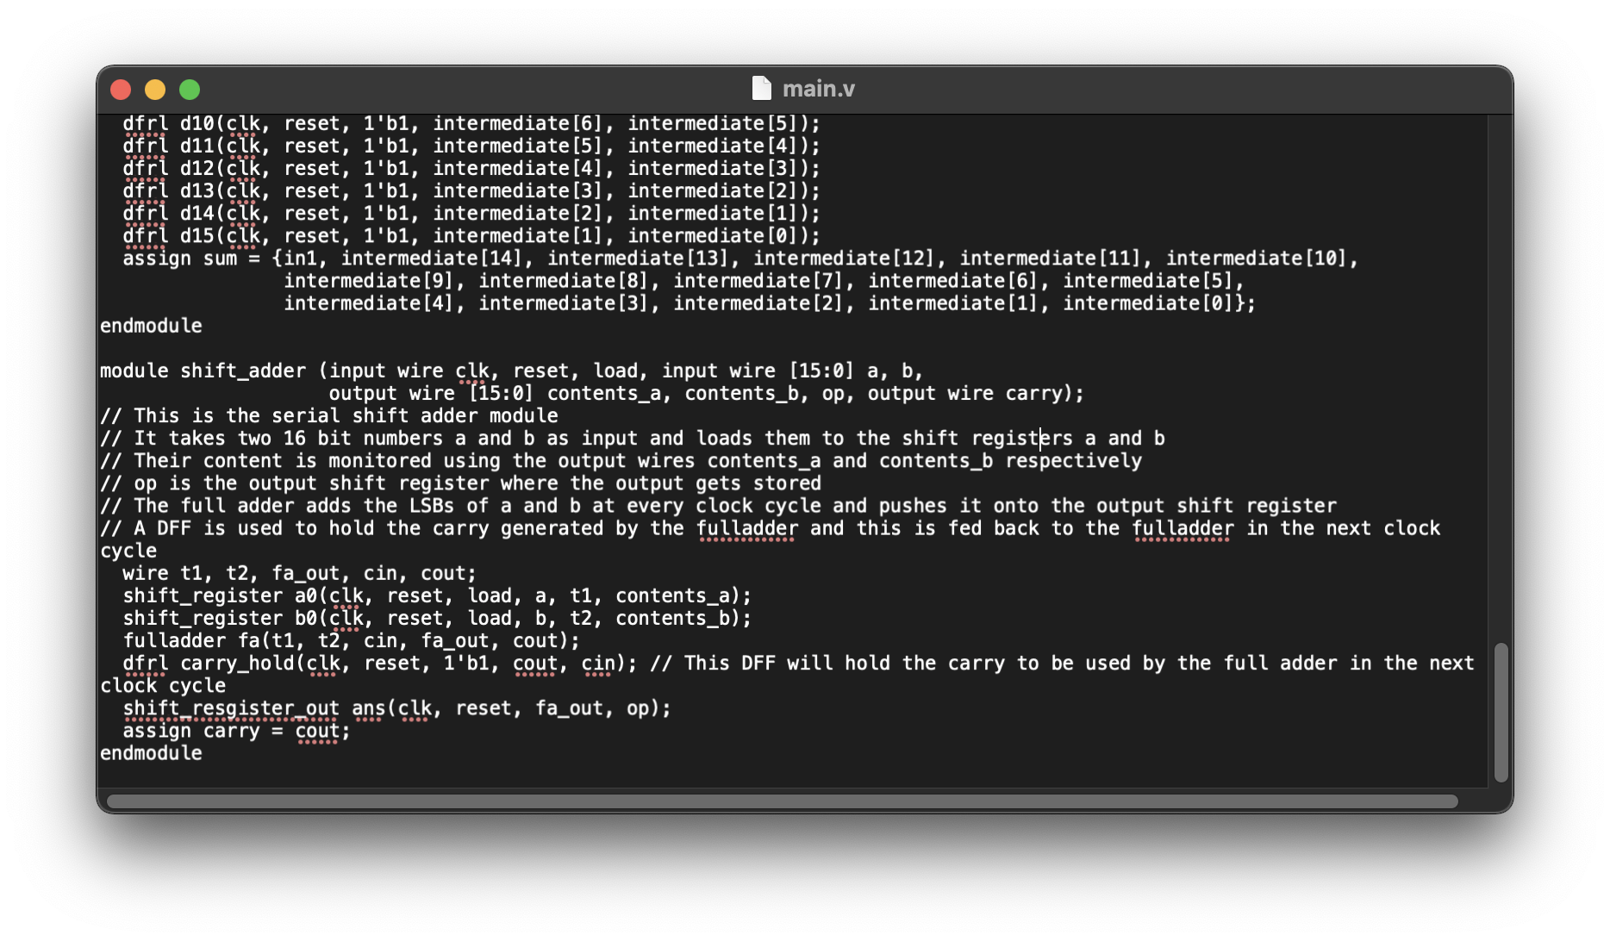

Slide 8
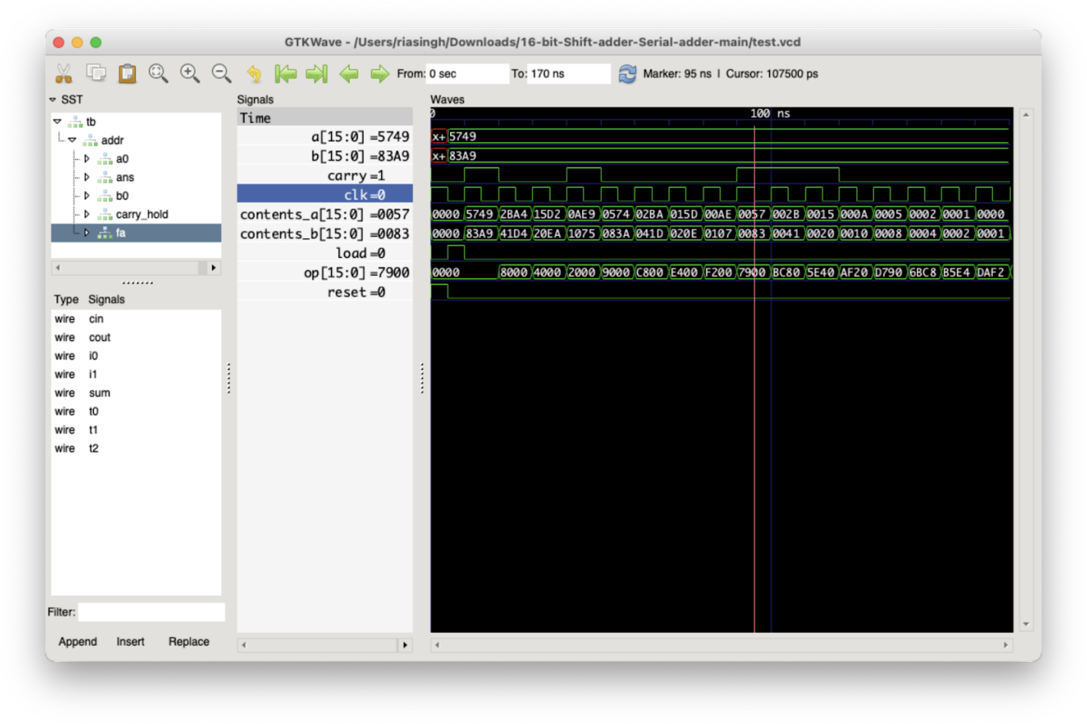
SCREENSHOTS

